Slide 2
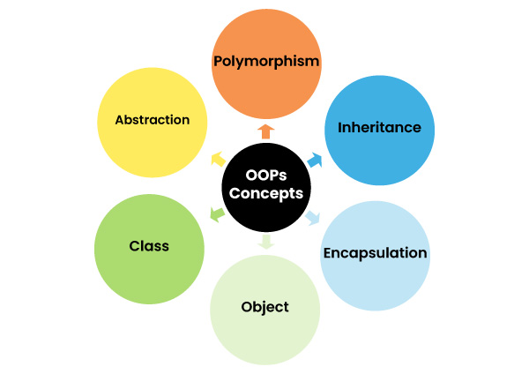
OOPS
Object-Oriented Programming or Java OOPs concept refers to programming languages that use objects in programming.
Object means a real-world entity such as a mobile, book, table, computer, watch, etc. Object-Oriented Programming is a methodology to design a program using classes and objects.

Slide 3
What is Java
Java is a high-level, general-purpose, object-oriented, and secure programming language developed by James Gosling at Sun Microsystems, Inc. in 1991.
It is formally known as OAK. In 1995, Sun Microsystem changed the name to Java. In 2009.
Java is a popular object-oriented programming language that enables programmers to create code that can run on any device that has a Java Virtual Machine (JVM).
Strong typing, automatic memory management a large library of standard libraries, and other features make it a popular choice for developing online services,
Android mobile apps, enterprise-level applications, and more. Its broad popularity across multiple industries can be attributed to its strong security features,

Slide 4
Editions of Java
Each edition of Java has different capabilities.
Java Standard Editions (JSE): It is used to create programs for a desktop computer.
Java Enterprise Edition (JEE): It is used to create large programs that run on the server and manages heavy traffic and complex transactions.
Java Micro Edition (JME): It is used to develop applications for small devices such as set-top boxes, phone, and appliances.
Java Card: It is a specialized edition of Java designed for smart cards and other small-memory devices, enabling secure elements in devices like SIM cards and credit cards.
JavaFX: JavaFX is a platform for creating Rich internet applications (RIAs) and is often considered alongside Java SE for desktop and web application development. It provides tools for building user interfaces and multimedia content.

Slide 5
Java Platform
Java Platform is a collection of programs. It helps to develop and run a program written in the Java programming language. Java Platform includes an execution engine, a compiler and set of libraries. Java is a platform-independent language.
Java Virtual Machine (JVM): The JVM is a component of the Java Platform, responsible for executing Java bytecode. JVM implementations are available for different platforms, allowing Java programs to run on diverse systems without modification.
Java Development Kit (JDK): The JDK is a software development kit that includes the necessary tools for developing Java applications. It consists of the Java compiler (javac), the Java runtime environment (JRE), and various development tools such as the debugger, and documentation generator. The JDK also includes the Java API (Application Programming Interface) documentation,
Java Standard Libraries: Java Platform provides a rich set of standard libraries known as the Java Standard Edition (Java SE) API. These libraries offer a wide range of functionality for tasks such as input/output operations, networking, data manipulation, concurrency, and graphical user interface (GUI) development. By leveraging these libraries, developers can build and feature-rich Java applications with minimal effort.

Slide 6
Object-Oriented: In Java, everything is in the form of the object. It means it has some data and behavior. A program must have at least one class and object.
Robust: Java makes an effort to check error at run time and compile time. It uses a strong memory management system called garbage collector. Exception handling and garbage collection features make it strong.
Garbage collection in Java is the automated process of deleting code that's no longer needed or used. This automatically frees up memory space and ideally makes coding Java apps easier for developers. Java applications are compiled into bytecode that may be executed by a JVM

Slide 7
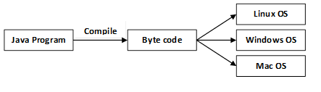
Secure: Java is a secure programming language because it has no explicit pointer and programs runs in the virtual machine. Java contains a security manager that defines the access of Java classes.
Platform-Independent: Java provides a that code writes once and run anywhere. This byte code is platform-independent and can be run on any machine.

Slide 8
Multi-threaded: Java also supports multi-threading. It means handling more than one job at a time. Multithreading is essential for building responsive and scalable applications, such as web servers, where multiple clients need to be serviced concurrently.
Dynamic: Java supports dynamic loading of classes and dynamic memory allocation, enabling features such as reflection and runtime type information. Reflection allows programs to examine or modify their own structure and behavior at runtime, facilitating advanced meta-programming techniques.
Scalable: Java's scalable architecture makes it suitable for developing applications ranging from small utilities to large-scale enterprise systems. Its modular design encourages code organization and reusability, making it easier to manage and maintain complex projects over time.

Slide 9
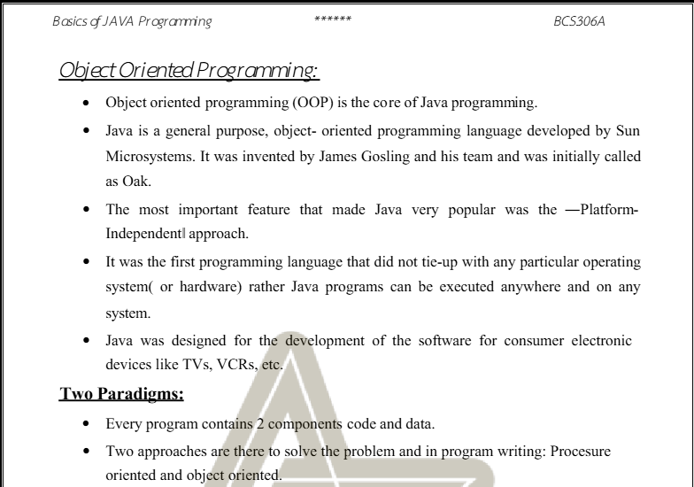

Slide 10
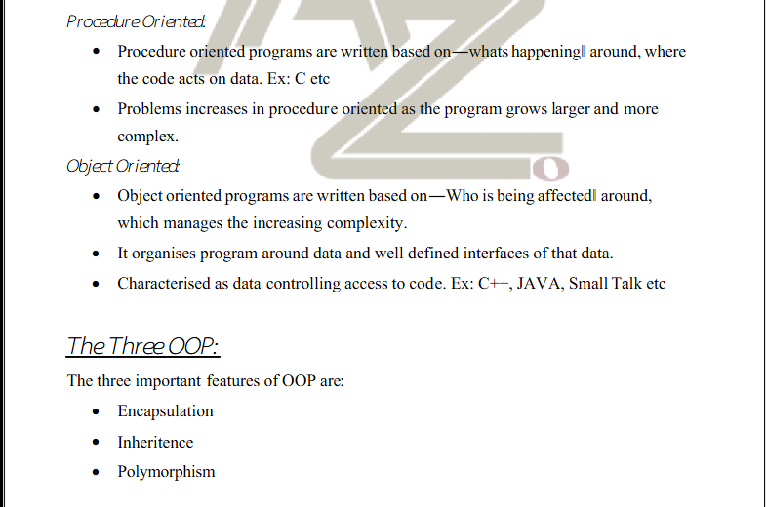

Slide 11
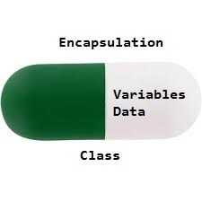
Encapsulation in Java is a fundamental OOP (object-oriented programming) principle that combines data and methods in a class. It allows implementation details to be hidden while exposing a public interface for interaction.
Declare the variables of a class as private.
Provide public setter and getter methods to modify and view the variables values.

Slide 12
Inheritance is an important pillar of OOP(Object-Oriented Programming). It is the mechanism in Java by which one class is allowed to inherit another class.
In Java, Inheritance means creating new classes based on existing ones. A class that inherits from another class can reuse the methods and fields of that class. In addition, you can add new fields and methods to your current class as well.
Why Do We Need Java Inheritance?
Code Reusability: The code written in the Superclass is common to all subclasses. Child classes can directly use the parent class code.

Slide 13
import java.io.*;
// Base or Super Class
class Employee {
int salary = 60000;
}
// Inherited or Sub Class
class Engineer extends Employee {
int benefits = 10000;
}
// Driver Class
class Gfg {
public static void main(String args[])
{
Engineer E1 = new Engineer();
System.out.println("Salary : " + E1.salary
+ "\nBenefits : " + E1.benefits);
}
}

Slide 14
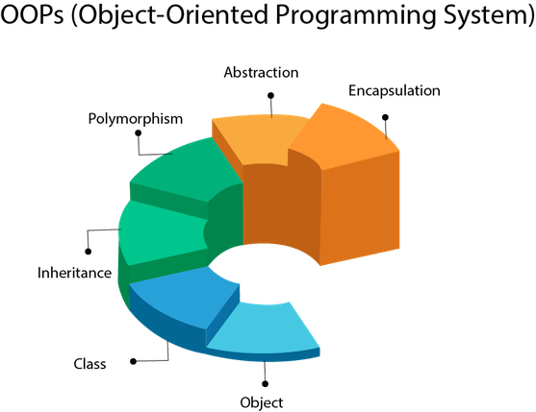

Slide 15
Object
An Object is a basic unit of Object-Oriented Programming that represents real-life entities. A typical Java program creates many objects, which as you know, interact by invoking methods. The objects are what perform your code, they are the part of your code visible to the viewer/user.
State: It is represented by the attributes of an object.
Behavior: It is represented by the methods of an object.
Identity: It is a unique name given to an object that enables it to interact with other objects.
Method: A method is a collection of statements that perform some specific task and return the result to the caller

Slide 16
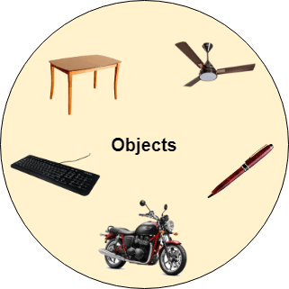
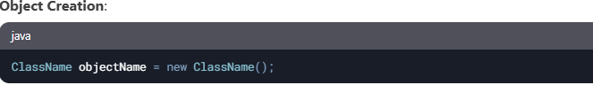
Object
An Object is a basic unit of Object-Oriented Programming that represents real-life entities. A typical Java program creates many objects, which as you know, interact by invoking methods. The objects are what perform your code, they are the part of your code visible to the viewer/user.
State: It is represented by the attributes of an object.
Behavior: It is represented by the methods of an object.
Identity: It is a unique name given to an object that enables it to interact with other objects.
Method: A method is a collection of statements that perform some specific task and return the result to the caller

Slide 17

// Define a class named 'Car'
class Car {
// Instance variable
String color;
// Method to display the color of the car
void displayColor() {
System.out.println("The color of the car is: " + color);
}
}
// Main class to create and use the Car object
public class Main {
public static void main(String[] args) {
// Create an object of the Car class
Car myCar = new Car();
// Set the color of the car
myCar.color = "Red";
// Call the method to display the color
myCar.displayColor();
}
}

Slide 18
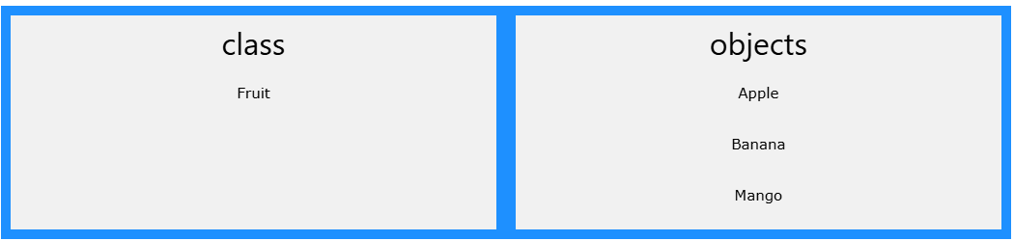
Class
Collection of objects is called class. It is a logical entity.
A class can also be defined as a blueprint from which you can create an individual object.
Properties of Java Classes
A class does not take any byte of memory.
It's a blueprint where we specify the functionalities.
A class contains mainly two things: Methods and Data Members.
Classes follow all of the rules of OOPs such as inheritance, encapsulation, abstraction, etc.

Slide 19
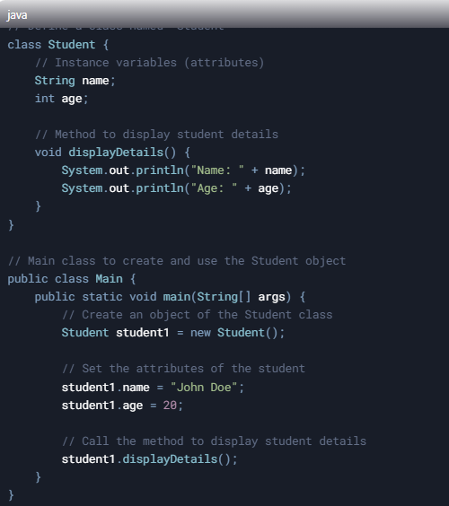
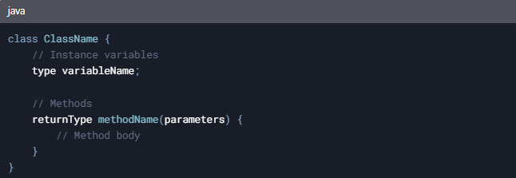
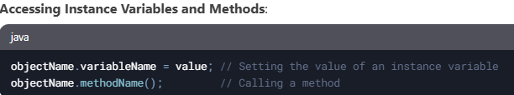
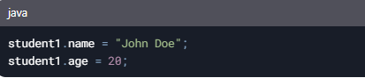
cv
OUTPUT

Slide 20
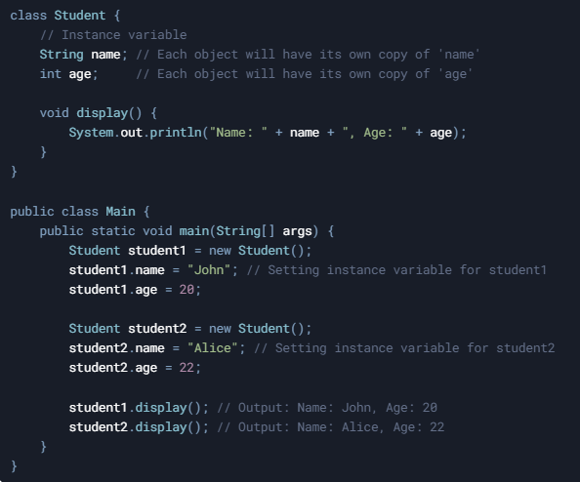
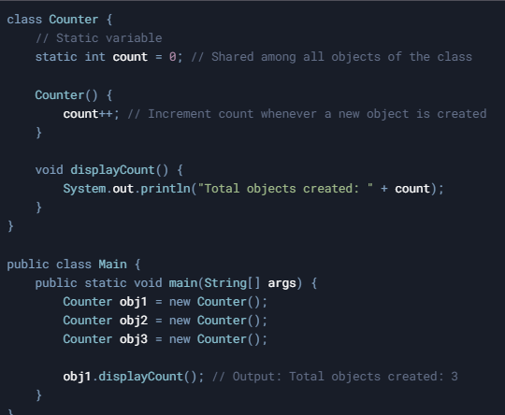
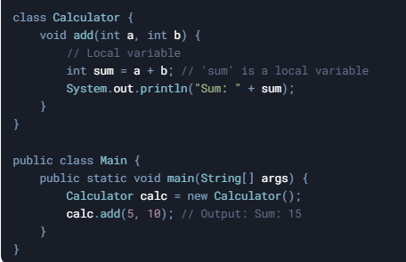
Types of Class Variables
Instance Variables
Static Variables (Class Variables)
Local Variables

Slide 21
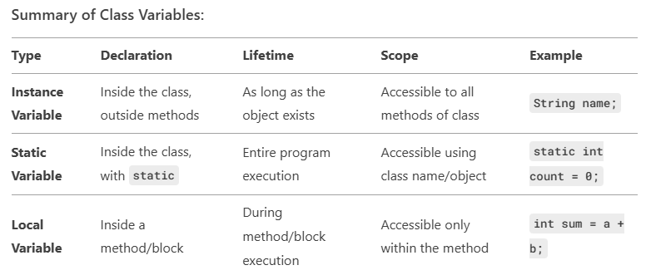

Slide 22
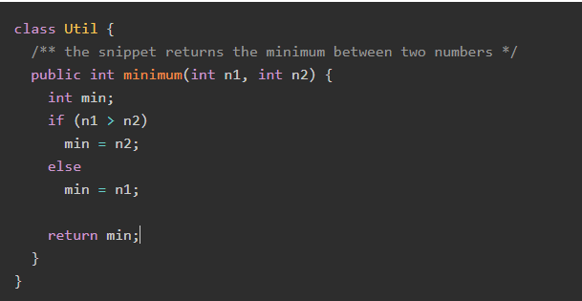
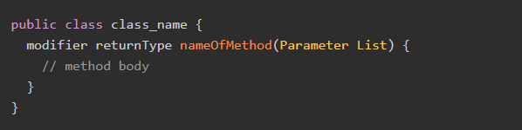
Creating (Declaring) Java Class Methods
modifier − It defines the access type of the method and it is optional to use.
returnType − The returns data type of the class method.
nameOfMethod − This is the method name. The method signature consists of the method name and the parameter list.
Parameter List − The list of parameters, it is the type, order, and number of parameters of a method. These are optional, method may contain zero parameters.
method body − The method body defines what the method does with the statements.

Slide 23
Polymorphism
If one task is performed in different ways, it is known as polymorphism.
n Java, we use method overloading and method overriding to achieve polymorphism.
Method Overloading
Definition: Method overloading occurs when a class has multiple methods with the same name but different parameters (different number of parameters, types of parameters, or order of parameters).
Purpose: It allows you to perform the same operation in different ways depending on the input.
Rules:
Methods must have the same name.
Methods must have different parameter lists (number, type, or order of parameters).
Return type can be the same or different.
Overloading can happen in the same class or in a subclass.

Slide 24
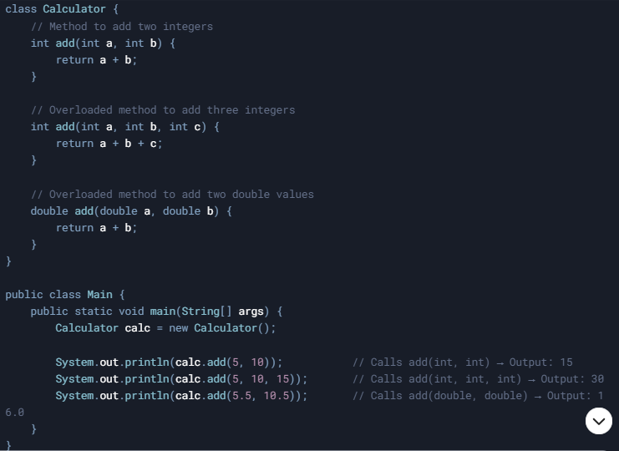

Slide 25
Method Overriding
Definition: Method overriding occurs when a subclass provides a specific implementation of a method that is already defined in its superclass.
Purpose: It allows a subclass to modify or extend the behavior of a method inherited from its superclass.
Rules
The method in the subclass must have the same name, return type, and parameters as the method in the superclass.
The method in the subclass must have the same or a more accessible access modifier (e.g., you cannot override a public method with a private method).
Method overriding is used for runtime polymorphism.

Slide 26
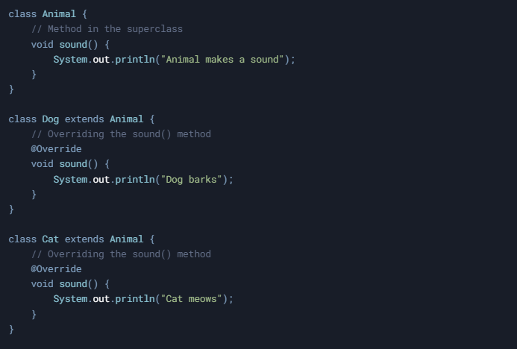

Slide 27
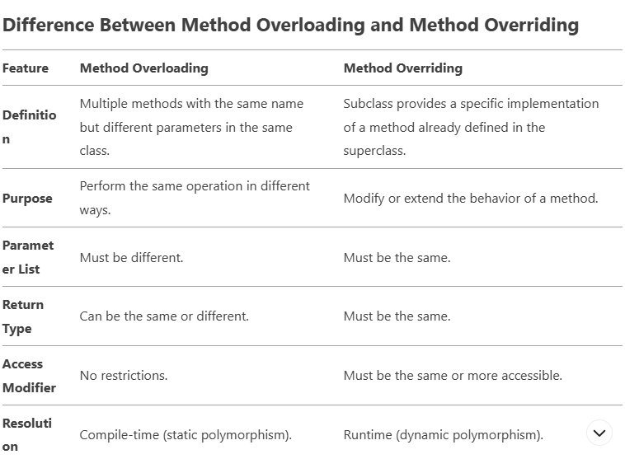

Slide 28
Abstraction Hiding internal implementation and showing functionality only to the user is known as abstraction. For example, phone call, we do not know the internal processing.
Encapsulation
Binding (or wrapping) code and data together into a single unit are known as encapsulation.
Encapsulation is one of the four fundamental principles of Object-Oriented Programming (OOP). It refers to the concept of bundling data (attributes) and methods (behavior) that operate on the data into a single unit (class) and restricting direct access to some of the object's components. This is typically achieved using access modifiers (like private, public, protected) and getter/setter methods.

Slide 29
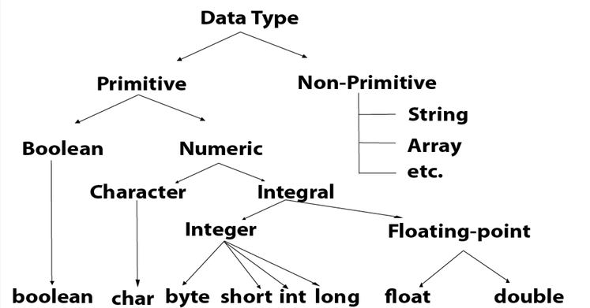

Slide 30
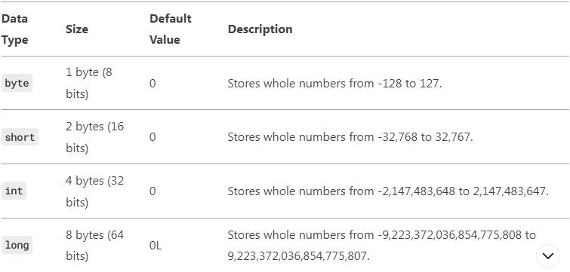
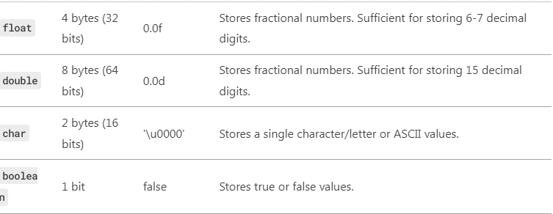

Slide 31
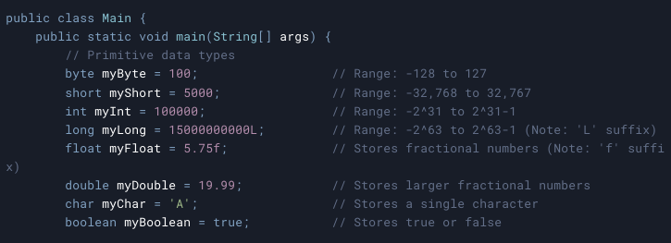
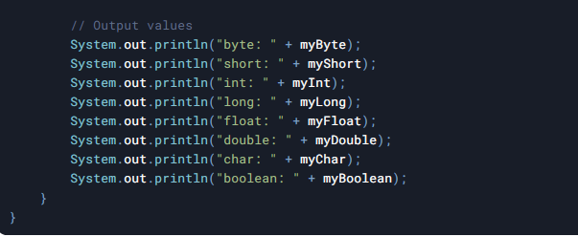

Slide 32
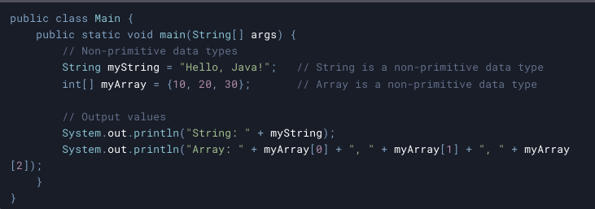
Non-Primitive Data Types
Strings
Arrays
Classes
Interfaces

Slide 33
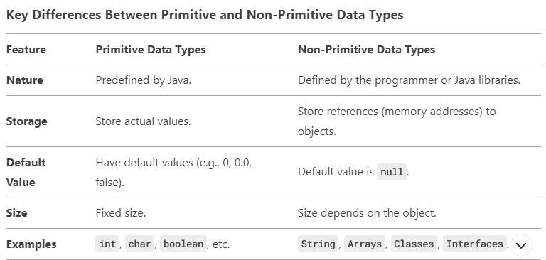

Slide 34
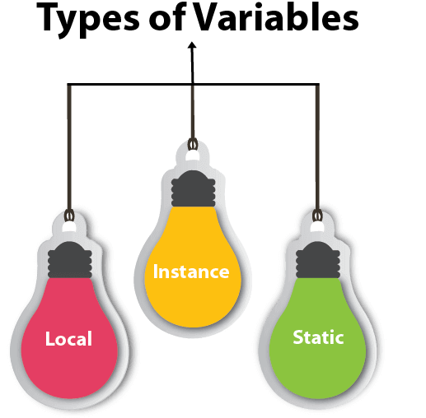
variable
A variable is a container which holds the value while the Java program is executed. A variable is assigned with a data type.
Local Variable
variable declared inside the body of the method is called local variable
Instance Variable
variable declared inside the class but outside the body of the method
Static variable
A variable that is declared as static is called a static variable

Slide 35
Operators
Operator in Java is a symbol that is used to perform operations. For example: +, -, *, / etc.
Arithmetic Operator,
Shift Operator,
Relational Operator,
Bitwise Operator,
Logical Operator,

Slide 36
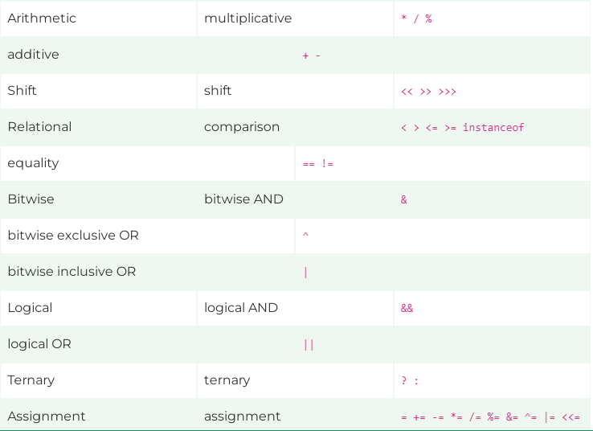

Slide 37
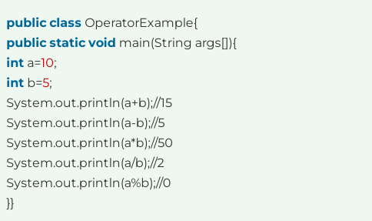
Java Arithmetic Operator Example

Slide 38
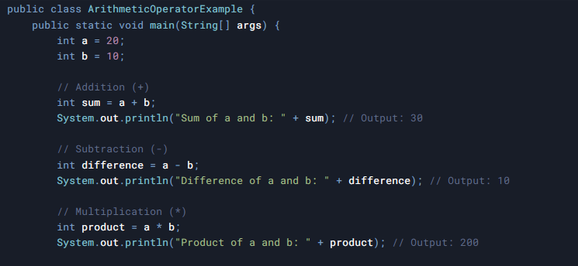
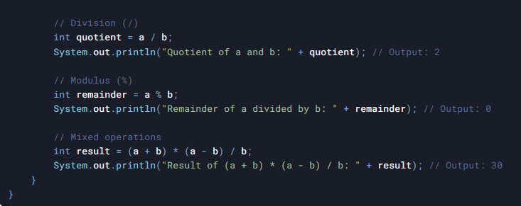

Slide 39
- , Negates the value.
+ , Indicates a positive value (automatically converts byte, char, or short to int).
++ , Increments by 1.
Post-Increment: Uses value first, then increments.
Pre-Increment: Increments first, then uses value.
-- , Decrements by 1.
Post-Decrement: Uses value first, then decrements.
Pre-Decrement: Decrements first, then uses value.
! , Inverts a boolean value.

Slide 40
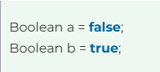
Boolean Data Type
the boolean data type represents a single bit of information with two possible states: true or false. It is used to store the result of logical expressions or conditions.
Example:
One key feature of the boolean data type is its use in controlling program flow. It is commonly employed in conditional statements such as if, while, and for loops to determine the execution path based on the evaluation of a boolean expression.
Boolean Variables
Conditional Statement
Boolean Expression
comparisons (e.g., >, <, ==) or logical operations (e.g., &&, ||, !).

Slide 41
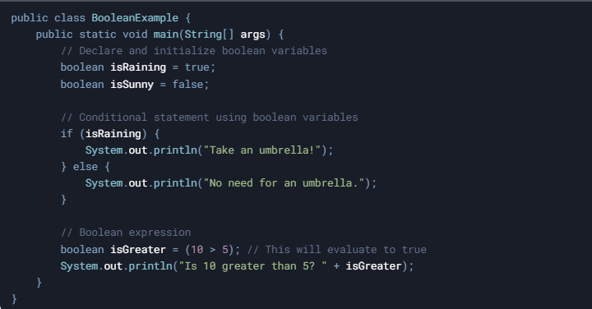

Slide 42
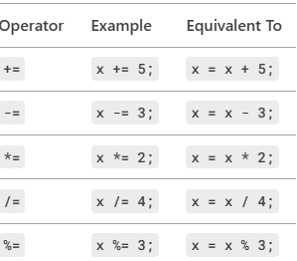

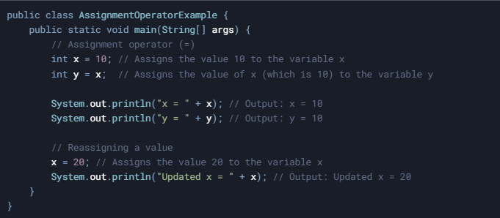
Assignment Operator
‘=’ Assignment operator is used to assign a value to any variable. It has right-to-left associativity,
format of the assignment operator

Slide 43
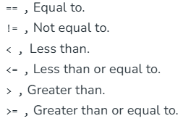
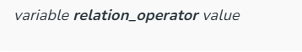
Relational Operators
Relational Operators are used to check for relations like equality, greater than, and less than. They return boolean results after the comparison and are extensively used in looping statements as well as conditional if-else statements.

Slide 44
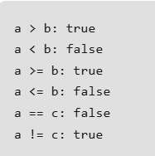
import java.io.*;
class EXP{
public static void main(String[] args)
{
// Comparison operators
int a = 10;
int b = 3;
int c = 5;
System.out.println("a > b: " + (a > b));
System.out.println("a < b: " + (a < b));
System.out.println("a >= b: " + (a >= b));
System.out.println("a <= b: " + (a <= b));
System.out.println("a == c: " + (a == c));
System.out.println("a != c: " + (a != c));
}
}

Slide 45
Logical Operators
Logical Operators are used to perform “logical AND” and “logical OR” operations, similar to AND gate and OR gate in digital electronics. They have a short-circuiting effect,
Conditional operators are:
&&, Logical AND: returns true when both conditions are true.
||, Logical OR: returns true if at least one condition is true.

Slide 46
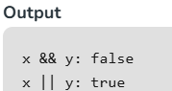
// Java Program to show the use of
// Logical operators
import java.io.*;
class operators {
// Main Function
public static void main (String[] args) {
// Logical operators
boolean x = true;
boolean y = false;
System.out.println("x && y: " + (x && y));
System.out.println("x || y: " + (x || y));
}
}

Slide 47
Java Control Statements | Control Flow in Java
Java compiler executes the code from top to bottom. The statements in the code are executed according to the order in which they appear.
However, Java provides statements that can be used to control the flow of Java code. Such statements are called control flow statements. It is one of the fundamental features of Java
Type of control Structure
Sequential Structure – Statements are executed one after the other
Selection Structure - Statements are executed based on conditions or decisions
Repetition Structure - Statements are executed repeatedly for a specified number of times.
Java provides three types of control flow statements.
Decision Making statements
if statements
switch statement

Slide 48
Loop statements
do while loop
while loop
for loop
for-each loop
Jump statements
break statement
continue statement

Slide 49
Decision-Making statements:
If Statement
In Java, the "if" statement is used to evaluate a condition. The control of the program is depending upon the specific condition.
The condition of the If statement gives a Boolean value, either true or false. In Java,
there are four types of if-statements given below.
Simple if statement
if-else statement
if-else-if ladder
Nested if-statement

Slide 50
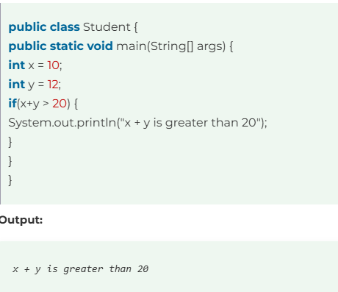
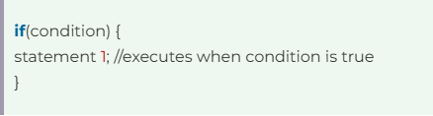
Simple if statement
It is the most basic statement among all control flow statements in Java. It evaluates a Boolean expression
Syntax of if statement

Slide 51
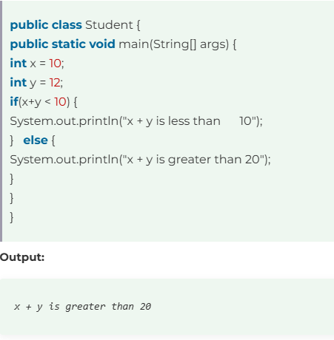
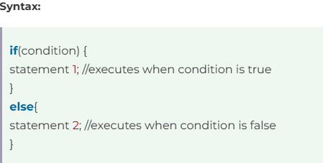
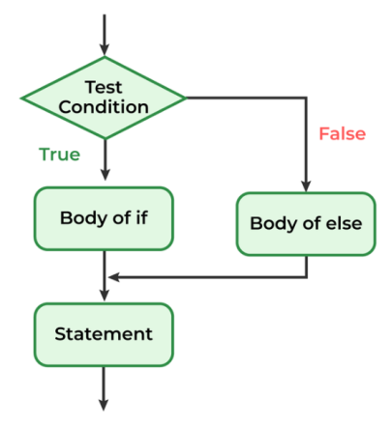
if-else statement
The if-else statement is an extension to the if-statement, which uses another block of code, i.e., else block.
The else block is executed if the condition of the if-block is evaluated as false.

Slide 52
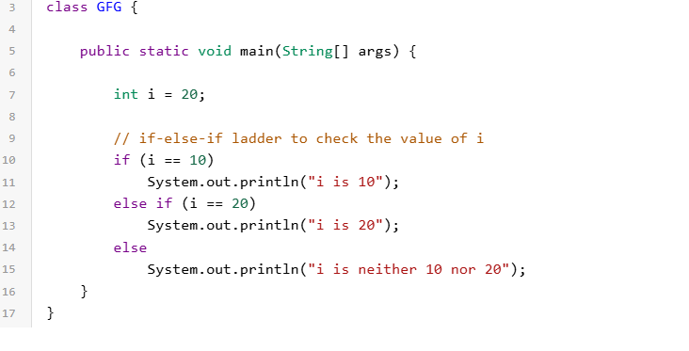
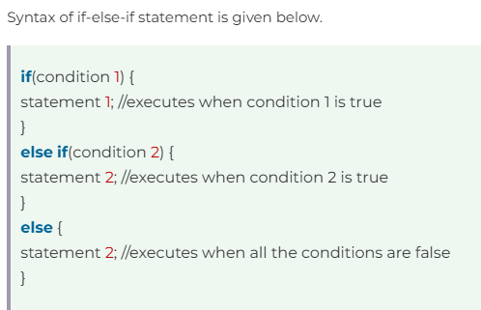
if-else-if
The if-else-if statement contains the if-statement followed by multiple else-if statements.
In other words, we can say that it is the chain of if-else statements that create a decision tree where the program may enter in the block of code where the condition is true.

Slide 53
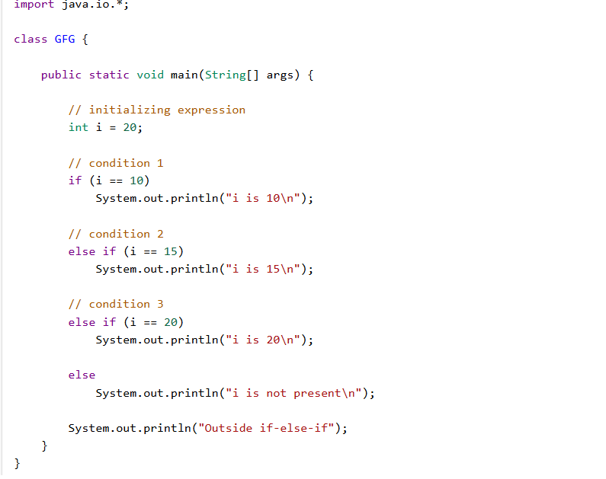


Slide 54


Slide 55


Switch Statement
The switch statement in Java is a multi-way branch statement. In simple words, the Java switch statement executes one statement from multiple conditions.

Slide 56



Slide 57
Looping
Looping in programming languages is execution of a set of instructions/functions repeatedly while some condition evaluates to true.
Java provides three ways for executing the loops. While all the ways provide similar basic functionality, they differ in their syntax and condition-checking time.
for loop
while loop
do-while loop

Slide 58


for loop
The for loop is use(we know how many times we want to repeat a task). The for statement consumes the initialization, condition, and increment/decrement in one line thereby providing a shorter, easy-to-debug structure of looping.

Slide 59
Initialization condition: Here, we initialize the variable in use. It marks the start of a for loop. An already declared variable can be used or a variable can be declared, local to loop only.
Testing Condition: It is used for testing the exit condition for a loop. It must return a boolean value
Statement execution: Once the condition is evaluated to true, the statements in the loop body are executed.
Increment/ Decrement: It is used for updating the variable for next.
Loop termination:When the condition becomes false, the loop terminates marking the end of its life cycle

Slide 60

import java.io.*;
class exp{
public static void main(String[] args)
{
for (int i = 0; i <= 10; i++) {
System.out.print(i + " ");
}
}
}

Slide 61



for each loop
This loop is used to over arrays or collections.

Slide 62


while Loop
A while loop is used when we want to check the condition before running the code.

Slide 63

import java.io.*;
class exp{
public static void main(String[] args)
{
int i = 0;
while (i <= 10) {
System.out.print(i + " ");
i++;
}
}
}

Slide 64


do-while Loop
The do-while loop in Java ensures that the code block executes at least once before the condition is checked.

Slide 65


do while loop starts with the execution of the statement(s). There is no checking of any condition for the first time.
After the execution of the statements, and update of the variable value, the condition is checked for true or false value. If it is evaluated to true, next iteration of loop starts.
When the condition becomes false, the loop terminates which marks the end of its life cycle.

Slide 66



Break statement
In java, the break statement is used to terminate the execution of the nearest looping statement or switch statement.
The break statement is widely used with the switch statement, for loop, while loop, do-while loop.

Slide 67
Method in Java
A method is a block of code or collection of statements or a set of code grouped together to perform a task or operation.
It is used to achieve the reusability of code. We write a method once and use it many times. We do not require to write code again and again.
It also provides the easy modification and readability of code, The most important method in Java is the main() method.
The main() method in Java holds a special place as the entry point for any standalone Java application. When a Java program is executed, the Java Virtual Machine (JVM) looks for the main() method to begin execution.
This method must adhere to a strict signature to be recognized by the JVM.
The main() is the starting point for JVM to start execution of a Java program. Without the main() method, JVM will not execute the program.

Slide 68


public: It is an access specifier. We should use a public keyword before the main() method so that JVM can identify the execution point of the program.
If we use private, protected, and default before the main() method, it will not be visible to JVM

Slide 69



Slide 70



main(): It is a default signature which is predefined in the JVM. It is called by JVM to execute a program line by line and end the execution after completion of this method.

Slide 71

String args[]
The main() method also accepts some data from the user. It accepts a group of strings, which is called a string array.
It is used to hold the command line arguments in the form of string values.
These arguments are stored into args[] array, so the name args[] is generally used for it.
Method Declaration

Slide 72
Access Specifier: Access specifier or modifier is the access type of the method. It specifies the visibility of the method. Java provides four types of access specifier:
Public: The method is accessible by all classes when we use public specifier in our application.
Private: When we use a private access specifier, the method is accessible only in the classes in which it is defined.
Protected: When we use protected access specifier, the method is accessible within the same package or subclasses in a different package.
Default: When we do not use any access specifier in the method declaration, Java uses default access specifier by default. It is visible only from the same package only.

Slide 73
Types of Method
Predefined Method
User-defined Method
Predefined Method
In Java, predefined methods are the method that is already defined in the Java class libraries is known as predefined methods.
It is also known as the standard library method or built-in method. We can directly use these methods just by calling them in the program at any point.
Some pre-defined methods are length(), equals(), compareTo(), etc.
Each and every predefined method is defined inside a class

Slide 74


we have used three predefined methods main(), print(), and max(). We have used these methods directly without declaration because they are predefined.
The print() method is a method of PrintStream class that prints the result on the console. The max() method is a method of the Math class that returns the greater of two numbers.

Slide 75


User-defined Method
The method written by the user or programmer is known as a user-defined method. These methods are modified according to the requirement

Slide 76


Constructors
In Java, a constructor is a block of codes similar to the method. It is called when an instance of the class is created.
At the time of calling constructor, memory for the object is allocated in the memory.
Every time an object is created using the new keyword, at least one constructor is called.
It is called constructor because it constructs the values at the time of object creation. It is not necessary to write a constructor for a class. It is because Java compiler creates a default constructor if your class does not have any.

Slide 77

Types of Java Constructors.
Default Constructor
If you do not create any constructor in the class, Java provides a default constructor that initializes the object.
Parameterized Constructor
A constructor with one or more arguments is called a parameterized constructor.

Slide 78


Default Constructor

Slide 79


Parameterized Constructor

Slide 80


Abstract Class
Java programming, abstract classes play an important role in defining the structure of classes and their behavior in the hierarchy.
Data abstraction is the process of hiding certain details and showing only essential information to the user.
Abstraction can be achieved with either abstract classes or interfaces
Abstract class: is a restricted class that cannot be used to create objects Abstract method: can only be used in an abstract class,

Slide 81


Slide 82



Slide 83
Java Arrays
Java, an array is a collection of elements of the same data type stored in contiguous memory locations.
Arrays in Java are fixed in size and can hold both primitive types (e.g., int, double) and objects (e.g., String).
Key Characteristics of Arrays
Fixed Size
Indexed Collection

Slide 84

Advantages
Code Optimization: It makes the code optimized, we can retrieve or sort the data efficiently.
Random access: We can get any data located at an index position.
Disadvantages
Size Limit: Arrays have a fixed size and do not grow dynamically at runtime.

Slide 85


Slide 86





Slide 87


Slide 88

Types of Arrays in Java
Single-Dimensional Arrays
These are the most common type of arrays, where elements are stored in a linear order.
// A single-dimensional array int[] singleDimArray = {1, 2, 3, 4, 5};

Slide 89


Slide 90

Multi-Dimensional Arrays
Arrays with more than one dimension, such as two-dimensional arrays (matrices).
// A 2D array (matrix) int[][] multiDimArray = { {1, 2, 3}, {4, 5, 6}, {7, 8, 9} };

Slide 91


Slide 92




Slide 93


Slide 94

String
Java, String is the type of objects that can store the sequence of characters enclosed by double quotes and every character is stored in 16 bits
An array of characters works same as Java string.

Slide 95

Java String Buffer Class
Java StringBuffer class is thread-safe i.e. multiple threads cannot access it simultaneously. So it is safe and will result in an order.

Slide 96

String Buffer Class append() Method
A String that can be modified or changed is known as mutable String. StringBuffer and StringBuilder classes are used for creating mutable strings.
meaning its contents can be modified without creating a new object. It is part of the
java.lang package and provides methods for modifying strings efficiently.

Slide 97


Slide 98


StringBuffer replace() Method

Slide 99

Use String when immutability is required.
Use StringBuffer when multiple modifications are needed in a multi-threaded environment.
Use StringBuilder when multiple modifications are needed in a single-threaded environment
(faster than StringBuffer).

Slide 100


Slide 101


Slide 102


Slide 103


Slide 104
Wrapper classes in Java
The wrapper class in Java provides the mechanism to convert primitive into object and object into primitive.
autoboxing and unboxing feature convert primitives into objects and objects into primitives automatically.
The automatic conversion of primitive into an object is known as autoboxing and unboxing.
Java is an object-oriented programming language, so we need to deal with objects many times like in Collections, Serialization, Synchronization, etc. Let us see the different scenarios, where we need to use the wrapper classes.

Slide 105
Change the value in Method: Java supports only call by value. So, if we pass a primitive value, it will not change the original value. But, if we convert the primitive value in an object, it will change the original value.
Serialization: We need to convert the objects into streams to perform the serialization. If we have a primitive value, we can convert it in objects through the wrapper classes.
Synchronization: Java synchronization works with objects in Multithreading.
java.util package: The java.util package provides the utility classes to deal with objects.
Collection Framework: Java collection framework works with objects only. All classes of the collection framework (ArrayList, LinkedList, Vector, HashSet, LinkedHashSet, TreeSet, PriorityQueue, ArrayDeque, etc.) deal with objects only.

Slide 106


Slide 107
Autoboxing
The automatic conversion of primitive data type into its corresponding wrapper class is known as autoboxing,
for example, byte to Byte, char to Character
Unboxing
The automatic conversion of wrapper type into its corresponding primitive type is known as unboxing.

Slide 108



Slide 109



Slide 110
Enumeration (Enum)
The enum in Java is a data type. It is used when we need to represent a fixed set of constants.
It can be used for days of the week (SUNDAY, MONDAY, TUESDAY, WEDNESDAY, THURSDAY, FRIDAY, and SATURDAY),
directions (NORTH, SOUTH, EAST, and WEST), season (SPRING, SUMMER, WINTER, and AUTUMN or FALL), colors (RED, YELLOW, BLUE, GREEN, WHITE, and BLACK) etc.
According to the Java naming conventions, we should have all constants in capital letters. So, we have enum constants in capital letters.

Slide 111



Slide 112
Annotation
Java Annotation is a tag that represents the metadata i.e. attached with class, interface, methods or fields to indicate some additional information which can be used by java compiler and JVM.
Annotations in Java are used to provide additional information, so it is an alternative option for XML and Java marker interfaces.
Built-In Java Annotations used in Java code
@Override
@SuppressWarnings

Slide 113


Slide 114
Annotations provide metadata for compilers, tools, and frameworks.
Built-in Annotations: @Override, @SuppressWarnings, etc.
Meta-Annotations: @Target, @Inherited, etc.
Custom Annotations: Created using @interface
Widely used in Java frameworks like Spring, Hibernate, JUnit.

Slide 115
Lambda Expressions
A lambda expression is a new and important feature of Java that was included in Java . It provides a clear and concise way to represent one method interface using an expression.
It is very useful in the collection library. It helps to filter and extract data from the collection.
The Lambda expression is used to provide the implementation of an interface that has a functional interface. It saves a lot of code. In the case of the lambda expression, we don't need to define the method again for providing the implementation.
Java lambda expression is treated as a function, so the compiler does not create a .class file.

Slide 116
Functionalities of Lambda Expression
Functional Interfaces: A functional interface is an interface that contains only one abstract method.
Code as Data: Treat functionality as a method argument.
Class Independence: Create functions without defining a class.
Pass and Execute: Pass lambda expressions as objects and execute on demand.

Slide 117

interface FuncInterface
{
// An abstract function
void abstractFun(int x);
// A non-abstract (or default) function
default void normalFun()
{
System.out.println("Hello");
}
}
class Test
{
public static void main(String args[])
{
FuncInterface fobj = (int x)->System.out.println(2*x);
fobj.abstractFun(5);
}
}

Slide 118



Structure of Lambda Expression

Slide 119



Lambda Expression Parameters
There are three Lambda Expression Parameters are mentioned below:
Zero Parameter
Single Parameter
Multiple Parameters

Slide 120

Zero Parameter
// Step 1: Define a functional interface
@FunctionalInterface
interface Exp{
void sayHello(); // Abstract method with zero parameters
}
public class LambdaExample {
public static void main(String[] args) {
// Step 2: Implementing lambda expression with zero parameters
Exp exp = () -> {
System.out.println("Hello, Welcome to Java Lambda Expressions!");
};
// Step 3: Calling the method using the lambda expression
exp.sayHello();
}
}

Slide 121
Single Parameter
// Step 1: Define a functional interface
@FunctionalInterface
interface Message {
void showMessage(String name); // Abstract method with one parameter
}
public class LambdaExample {
public static void main(String[] args) {
// Step 2: Implementing lambda expression with a single parameter
Message message = (name) -> {
System.out.println("Hello, " + name + "! Welcome to Java Lambda Expressions.");
};
// Step 3: Calling the lambda function
message.showMessage(“MCA");
}
}
Hello, MCA! Welcome to Java Lambda Expressions.

Slide 122
Lambda Expression with Multiple parameters
@FunctionalInterface
interface Functional {
int operation(int a, int b);
}
public class Test {
public static void main(String[] args) {
// Using lambda expressions to define the operations
Functional add = (a, b) -> a + b;
Functional multiply = (a, b) -> a * b;
// Using the operations
System.out.println(add.operation(6, 3)); // Output: 9
System.out.println(multiply.operation(4, 5)); // Output: 20
}
}

Slide 123

Java Package
A java package is a group of similar types of classes, interfaces and sub-packages.
Package in java can be categorized in two form, built-in package and user-defined package.
Advantage of Java Package
1) Java package is used to categorize the classes and interfaces so that they can be easily maintained.
2) Java package provides access.

Slide 126


Types of Packages in Java
Predefined packages
java.lang (Automatically imported, contains classes like String, Math, System)
java.util (Contains utility classes like ArrayList, HashMap, Collections)
java.io (For input/output operations)
java.net (For networking) java.sql (For database connectivity)
User-defined Packages

Slide 127
Key Classes in java.util Package
ArrayList – A resizable array.
LinkedList – A doubly linked list.
HashSet – A set that does not allow duplicates.
HashMap – A key-value pair data structure.
Stack – A Last-In-First-Out (LIFO) data structure.

Slide 128
Inheritance in Java
Inheritance in Java enables a class to inherit properties and actions from another class, called a superclass or parent class.
A class derived from a superclass is called a subclass or child group. Through inheritance, a subclass can access members of its superclass (fields and methods).
Inheritance represents the IS-A relationship which is also known as a parent-child relationship.
Why use inheritance in Java
For Method Overriding (so runtime polymorphism can be achieved).
For Code Reusability.

Slide 129
Terms used in Inheritance
Class: A class is a group of objects which have common properties. It is a template or blueprint from which objects are created.
Sub Class/Child Class: Subclass is a class which inherits the other class. It is also called a derived class, extended class, or child class.
Super Class/Parent Class: Superclass is the class from where a subclass inherits the features. It is also called a base class or a parent class.
Reusability: As the name specifies, reusability is a mechanism which facilitates you to reuse the fields and methods of the existing class when you create a new class. You can use the same fields and methods already defined in the previous class.

Slide 130





Slide 131


Types of Inheritance in Java
On the basis of class, there can be three types of inheritance in java: single, multilevel and hierarchical.
In java programming, multiple and hybrid inheritance is supported through interface only.

Slide 132




Single Inheritance

Slide 133




Multilevel Inheritance

Slide 134




Hierarchical Inheritance

Slide 135
Method Overriding
If subclass (child class) has the same method as declared in the parent class, it is known as method overriding in Java.
Usage of Java Method Overriding
Method overriding is used to provide the specific implementation of a method that is already provided by its superclass.
Method overriding is used for runtime polymorphism.
Method overriding allows subclasses to reuse and build upon the functionality provided by their superclass,

Slide 136

Rules
Same Method Name: The overriding method in the subclass must have the same name as the method in the superclass that it is overriding.
Same Parameters: The overriding method must have the same number and types of parameters as the method in the superclass.
IS-A Relationship (Inheritance): Method overriding requires an IS-A relationship between the subclass and the superclass.

Slide 137





Slide 138
Interface
An Interface in Java programming language is defined as an abstract type used to specify the behavior of a class. An interface in Java is a blueprint of a behavior
The interface in Java is a mechanism to achieve abstraction.By default, variables in an interface are public, static.It is used to achieve abstraction and multiple inheritances in Java
Java, an interface is a reference type similar to a class that contains only abstract methods (methods without a body) and constants. It is used to achieve abstraction and multiple inheritance in Java.
Key Features
Abstract Methods: Interfaces can only contain abstract methods.
No Instance Variables: Interfaces can have only public, static
Multiple Inheritance: A class can implement multiple interfaces, achieving multiple inheritance.

Slide 139



syntax of an interface in Java

Slide 140

Multiple Inheritance in Java Using Interface
Multiple Inheritance is an OOPs concept that can’t be implemented in Java using classes. But we can use multiple inheritances in Java using Interface.
Key
A class can implement multiple interfaces, inheriting their methods.

Slide 141



Slide 142

final Keyword in Java Interface
Java, the final keyword has different effects depending on where it is used. When it comes to interfaces, its usage is limited to variables only.
Key Rule: You cannot change the value of an interface variable because it is final by default.

Slide 143


Slide 144




Slide 145


Slide 146
Dynamic Method Dispatch in Java
Dynamic Method Dispatch (also called runtime polymorphism) is a mechanism in Java where a call to an overridden method is resolved at runtime.
method overriding where a parent class reference is used to call a method from a child class.
Dynamic Method Dispatch Works?
A parent class reference is assigned to an object of the child class.
When a method is called on this reference, Java determines at runtime which method (parent or child) to execute.

Slide 147



Slide 148


Slide 149

Generic Programming
Generic programming is a technique that allows writing code that works with different data types while ensuring type safety. Java supports generics to enable reusable, type-safe, and efficient code.

Slide 150
Casting Objects
Casting in Java is the process of converting one type into another. In object-oriented programming, object casting is used to convert an object of one class type to another within an inheritance hierarchy.
Types of Object Casting
Upcasting → Converting a subclass reference to a superclass reference.
Downcasting → Converting a superclass reference back to a subclass reference.
Upcasting
Upcasting is converting a subclass reference to a superclass reference. It happens automatically in Java. It restricts access to subclass-specific methods.

Slide 151



Slide 152




Slide 153

instanceof Operator
The instanceof operator in Java is used to test whether an object is an instance of a specific class or subclass. It returns true if the object belongs to the specified type, otherwise false.

